Slide 1


Equipe Rapide Sports Car Club
Est. 1958
Non-profit 501(c)3 Corp.
https://www.erscc.com

Slide 2
Safety
Safety is our priority, please respect the venue and refrain from burnouts, donuts, drifting, unnecessary revving
Autocrossers make this a family event and there are often children in the paddock, speed limit is 5 mph
If you see something, say something
Equipe Rapide is a club where all participants have the authority and responsibility to report and prevent hazardous behavior

Slide 3
Event agenda
7:00 AM Gates open
8:00 AM Pick up your self-tech card from registration desk and sign attestation
8:00 AM - 9:00 AM Course is open for walking
8:45 AM- Novice course walk-through (we will teach you how to read the course)
9:00 AM Drivers’ meeting (everyone on site must attend, including spectators)
Run Group 1 report to grid
Work Group 1 report for your work assignment
First car on course after stations are staffed
We follow SCCA format in which participants must work during 1 run group as assigned by organizer

Slide 4
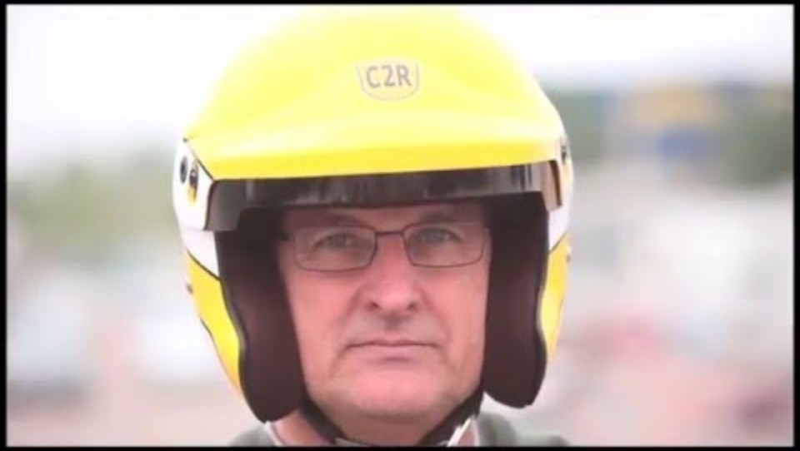
Autocross FAQs & resources
Car classifications: https://www.scca-classifier.com/a/index.html
Quick reference Guide: https://cdn.connectsites.net/user_files/scca/downloads/000/044/544/Quick_Reference_of_Category_Allowances_%284%29.pdf?1715979271
SCCA Autocross (Solo) rules: https://www.scca.com/pages/solo-cars-and-rules
Click here for more autocross vocabulary

Slide 5
Requirements
Valid drivers’ license
Vehicle in good mechanical condition (no loose parts, no missing lug nuts) and pass tech inspection
Battery must be secure. NO BUNGEE CORDS! Loose batteries start fires!
Healthy tires, no cords or defects
Must have a seatbelt and you must wear a Snell approved helmet (We have loaners, see timing table)
Take out the floor mats, spare tire and anything that could roll around under your feet when you stomp on the brakes.
Closed toe shoes (insurance requirement).
Display your car number in contrasting color on both sides of the car.
Signed waiver and wristband
All participants are required to report to work during their assigned work group. Failure to report will result in disqualification from the event, all times will be removed.
Anyone needing special work accommodations, please speak to event organizers and we will assist

Slide 6
Registration
Register in advance and pay online: https://www.driverregistration.com/
If you’re unsure of your car class, select the one that fits best and consult with organizers at the registration desk
Online registration closes at 11:59 pm on Thursday before the event
On-site registration incurs a $20 upcharge and is cash only
Minors must be accompanied by legal guardian who will need to sign a “minor waiver’, as well as a valid drivers’ license

Slide 7
Preparation
Some autocrossers invest in a plastic storage box to keep their essentials protected from the elements during the event
Useful items:
Lawn chair, canopy, umbrella, rain jacket/poncho
Wear light colors, no tank tops if you’re driving. Shorts OK
Closed toe shoes are required, comfortable athletic shoes recommended
Hat, sunglasses, sunscreen, hydration, snacks (we don’t break for lunch)
WATERRRR!!!
Painters’ tape in a color that contrasts your car color
Duct tape, tie wraps
No loose car parts, all lug nuts must be present, tires must be in healthy condition
Did you forget something? Ask around, we’re a friendly bunch!

Slide 8
Morning of the event
Arrive at venue 7 am- 8 am
Park in the designated paddock area and empty car of any loose items
Get your drivers’ license and report to the registration desk to obtain your tech card
Sign waiver (all attendees must sign waiver, including spectators) to get a wristband
Review tech card and ensure the checklist is complete- then sign it
Your car # is on the top right corner of the tech sheet.
Use tape or magnetic #’s to display your car # on both sides of the car in a contrasting color
Numbers must be at least 8 inches tall
Run groups are published online upon the closing of registration
Walk the course as many times as you can!

Slide 9
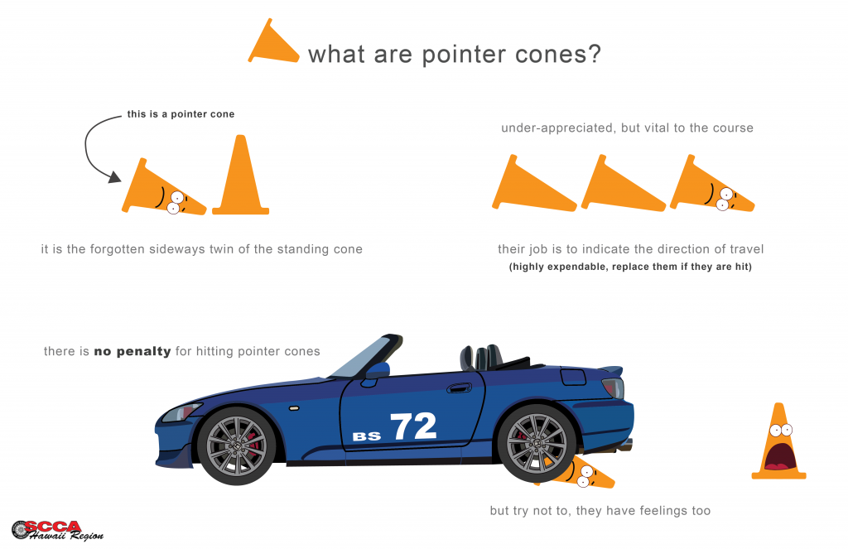
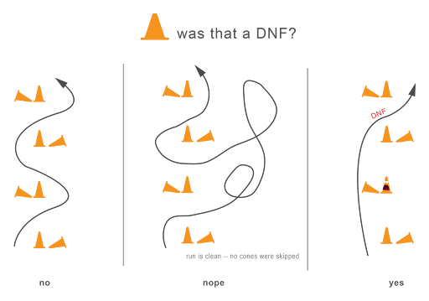
Reading cones

Slide 10

Penalties
1 cone = +2 second penalty
Cones before start line or after finish line are a +4 second penalty each
Going off course results in no time DNF penalty

Slide 11
Live timing and scoring
Follow live timing here: https://www.erscc.com/livetiming/
You can see your score within the car class, raw times, or PAX times
What are PAX times?
"PAX times" refer to a driver's time adjusted based on their car's performance potential, using a system called the "Professional Autocross (PAX) Index," which essentially handicaps different car classes to allow for a more equitable comparison between drivers with varying vehicles; essentially, it's a way to compare driver skill across different car types by multiplying their raw time by a factor specific to their car class.
Purpose: To level the playing field by adjusting times based on the inherent speed of a car, allowing drivers in slower cars to compete more fairly against drivers in faster cars.
Calculation: Each car class is assigned a PAX factor, which is then multiplied by the driver's actual time to produce their "PAX time" or "indexed time".
Interpretation: A driver with a faster PAX time, even if their raw time was slower, means they performed better relative to their car's potential.

Slide 12
Follow us on social media!
Instagram: @ERSCC_Autocross
Facebook: https://www.facebook.com/ERSCC/?mibextid=lqqj4d
Linked in: https://linkedin.com/company/erscc
X: https://x.com/rapide_clu9957
Registration concerns: ER-REG@carlc.com
Photos and non-urgent emails: EquipeRapideSCC@gmail.com

